Slide 1

By Tanish Kandivlikar
RETAIL ANALYTICS

Slide 2
PLAN
Background
Objective
Identifying top products
Market Basket Analysis
Key Findings & Recommendations

Slide 3
BACKGROUND
OList is one such e-commerce company that has faced some losses recently and they want to manage their inventory very well so as to reduce any unnecessary costs that they might be bearing.
Now, some of these warehoused products might be fast-moving products which sell very quickly and some others might be slow-moving. Each of the products being stored incurs a cost to the company in terms of space and maintenance.
Since storing these products obviously add to the costs that the company incurs, it is absolutely necessary for the organizations to plan their inventory well.

Slide 4
OBJECTIVE
To identify top products that contribute to the revenue and also use market basket analysis to analyze the purchase behavior of individual customers to estimate with relative certainty what items are more likely to be purchased individually or in combination with some other products.
To provide recommendations to increase the revenue.

Slide 5
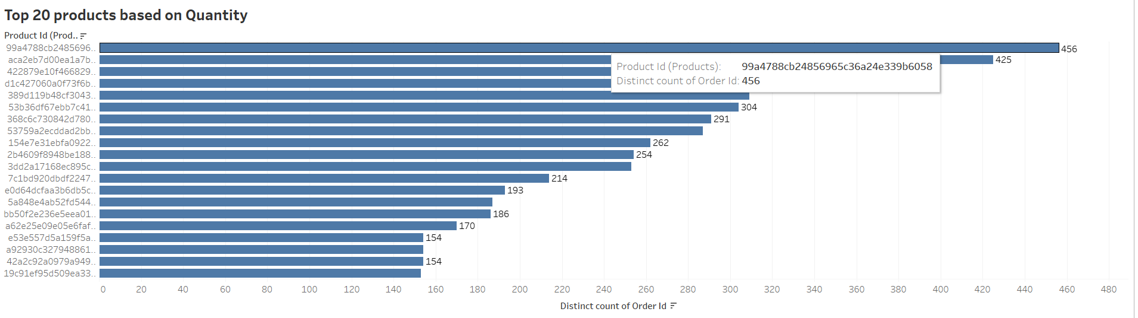
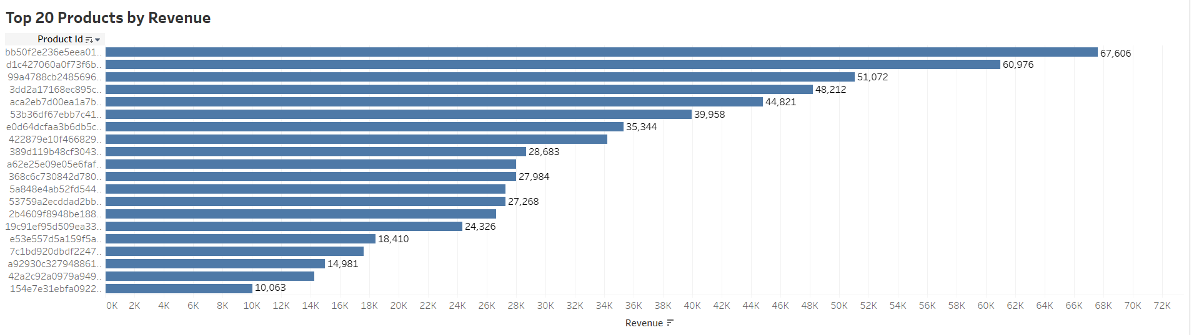
What are our top products?
We have identified the top 20 ordered products by quantity and revenue hence we can focus on these products quality and hence increase their inventory.

Slide 6
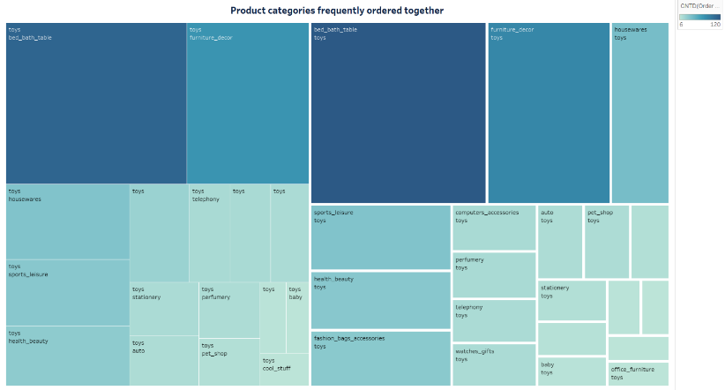
MARKET BASKET ANALYSIS
Combinations of product categories which are frequently ordered together are visualized.
This has been done by creating a simple matrix with product categories in the rows and columns and then checking which of the pairs show associations.

Slide 7
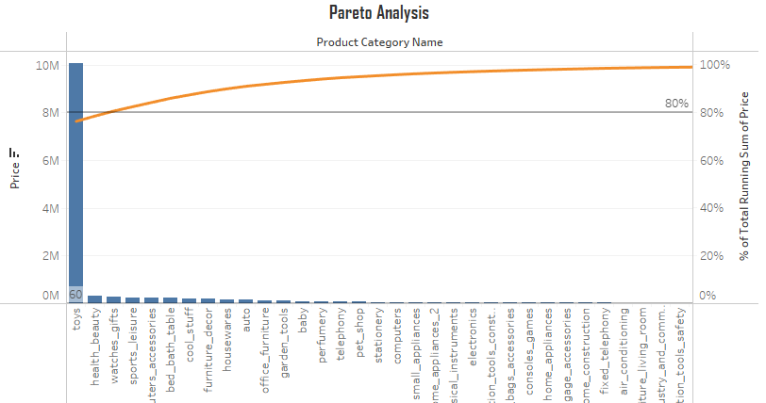
PARETO ANALYSIS
We have used the 80-20 rule
of pareto analysis.
We have done this by calculating the running total of sum of price with respect to different product categories.

Slide 8
Recommendation
As per exploratory data analysis and market basket analysis, we can see that product category which belongs to bed bath tables, furniture décor, health and decor and toys contributed to most of the revenue as well frequently bought hence we must focus on these products inventory as well as quality.
Whereas we must limit the inventory of home construction, accessories and perfumes as they are not much ordered and also not very frequently bought this maybe because consumers taste changes with trend.
Hence if we can plan the inventory accordingly , we can increase profit margin of O-list.

Slide 9
THANK YOU!
ANY QUESTIONS?

